Slide 1
Week 4
Akshat Iyer, Andrew Wu, Eugene Kim, Sebastian Perez, Will Noonan

Slide 2
Problem Statement
We are optimizing the location of movable concession stands within existing stadiums in order to maximize revenue based on crowd behavior.
Our goal is to create a simulation framework that can determine the best locations for movable concessions stands given the stadium layout.

Slide 3
Optimization Reasoning
The sports industry is lucrative, and one of the main factors driving revenue is the sale of concessions to fans.
The location of concession stands has to be approached with careful consideration, as it can have a significant impact on how much is able to be sold.
By devising a system to optimize the location of concession stands for a specific stadium layout, revenue could be increased significantly.

Slide 4
Methodology
Construct a simulation with different classes of rational agents as humans interacting with the environment (stadium).
Monitor the agents over a period of time and make note of the revenue a specific real-world configuration generates.
Tune our simulation until those values match real-world reports.
Use the updated simulation parameters with differing locations to find the optimal configuration.

Slide 5
Setup
Python Simulation of an MxN grid
X Agents with some algorithm A logical reasoning
Y Places of Interest (POI)
Concession Stands
Seating
Time Step Function
Every step an agent takes an action based on their reasoning algorithm
Reward Function
Sum of rewards from when an agent lands on a POI

Slide 6
Data
Our team will need real-world data regarding current stadium configurations, attendance numbers, and revenue generated.
This data is needed to tune our simulation to the real-world parameters that people operate by.

Slide 7
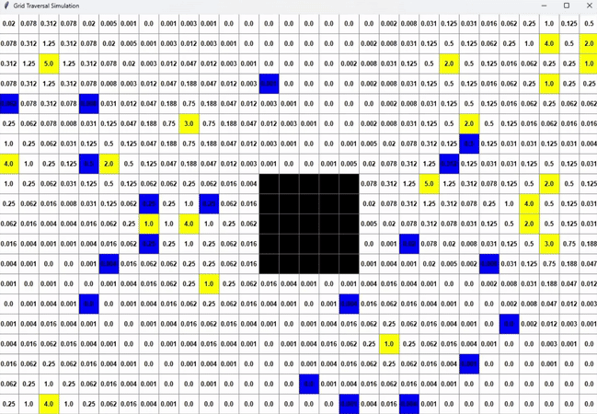
Current Work
Basic simulation grid is complete
Supports custom grid shapes with invalid movement spaces (e.g. the field)
Agents take random actions
Basic reward function is complete
Reward is summed whenever an agent lands on a reward square

Slide 8
Future Work
Create different classes of agents that can interact with the environment. Examples include people who really want to watch the game, people who are indifferent to the game, and people sitting in different sections.
Model the real-world actions of these agents.
Expand the simulation grid to match real-world stadiums.

Slide 9
Possible Roadblocks
Difficulty in modeling human behavior
Either requires assumptions on human behavior or data to support stadium behavior
Difficulty in accurately modeling a stadium
Official stadium data and dimensions are not readily available to the public, requires some outreach

